Slide 1

Waze
KHEDHER Abdessalem, MILLAVET Maxime, BERTI Charles

Slide 2
What is Waze ?
Community-driven GPS navigation app
Help you find directions and avoid traffic jams
Real-time directions
Alert the user to important items like accidents
Socialization app

Slide 3
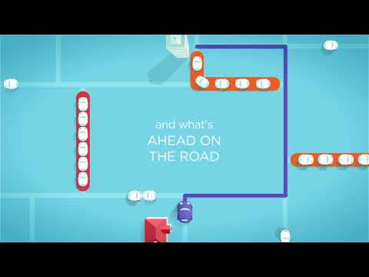
Waze, outsmarting traffic, together

Slide 4
Navigation Devices : Context
Mobile Apps: Google Maps, Plans, Baidu Maps, QQ Map
Classic devices: TomTom, Garmin
Integrated devices: Renault, Peugeot…
Used Before (10 years ago) and nowadays : still the same, apparition and rise of mobile apps. Few actors but not many new entrants.
Waze was released in 2006 and revolutionized the market

Slide 5
Short Story of Waze
2006: FreeMap Israel, Community Project
2009: renamed Waze
2011-2012: real time, community points of interest, events (protests), fuel prices displaied (not available in every country)
2013: Bought by Google
2017: Partnership with Spotify so that users can play Spotify music displaying Waze app for navigation. Available on Android and IOS

Slide 6
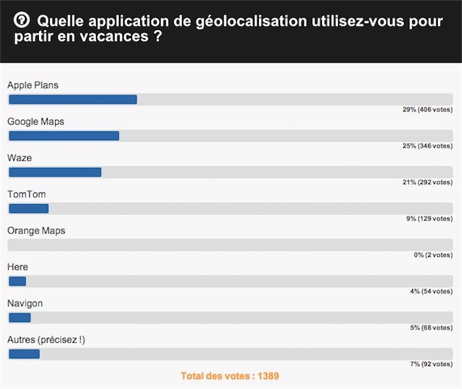
Waze in France compared to other tools
Waze stands on 3rd position for Mobile apps most used in 2015 for going on holiday trip.
On June 11th Waze was the most downloaded free navigation map on AppleStore in France and second most downloaded behind Google Maps in the US according to this website.

Slide 7
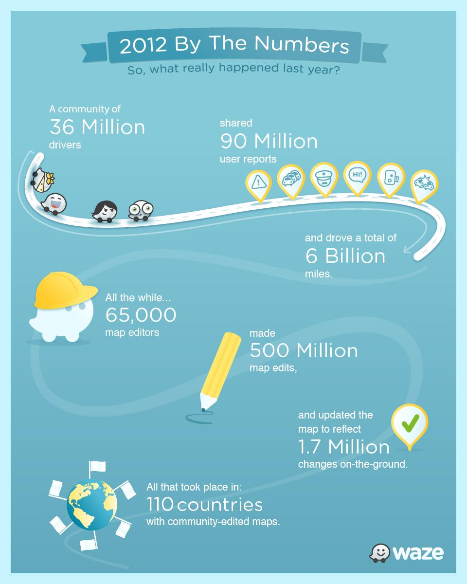
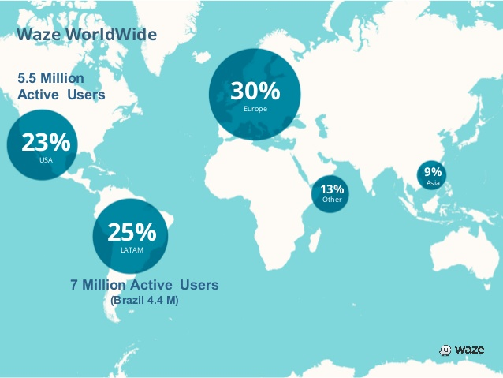
WorldWide Use

Slide 8
Impact
The user experience is at the core of the Waze App. The reason behind its success is reflected in its motto «Outsmarting traffic, together» : its community is its greatest strength and forms its added value. The app create a sense of unity and solidarity among drivers and is a perfect exemple of collaborative economy.
The knowledge is shared, like with Wikipedia for instance, but in the case of Waze every user is a contributor. This idea caught the eye of Google who bought the company for its innovation and brought Waze at 28th place of the world most innovative companies of 2018 according to this website.

Slide 9
Why Use Waze? The Big Ideas
Community-based real-time informations: cops, speed checkers, low speed areas, car crash… Every user can alert on this so that others can take another road (generated by the app which noticed the « problem »), or reduce their speed.
Allow communication between users: when people go to the same place or when you’re supposed to pick-up somebody, can see him on the map.
Check services available on your route (Gas station, restaurant…)

Slide 10
Sources
Waze : https://www.waze.com/fr/
Wikipedia : https://en.wikipedia.org/wiki/Waze
YoutTube : https://youtu.be/66jehpnKoUA
Lifewire : https://www.lifewire.com/what-is-waze-4153570
FastCompany : https://www.fastcompany.com/40525518/how-waze-works-with-local-governments-to-clear-the-roads
SimilarWeb :
https://www.similarweb.com/apps/top/apple/store-rank/fr/navigation/top-free/iphone

